Slide 1
Nassi-Schneidermann Diagram
Representation for a Program(code)

Slide 2
Three basic control Structures
Sequence
Selection
Repetition

Slide 3
Sequence
Statement a
Statement b
Statement c

Slide 4
Selection
IF condition p true
yes
no
Statement a
Statement b

Slide 5
Repetition
DOWHILE condition p is true
 | Statement block

Slide 6
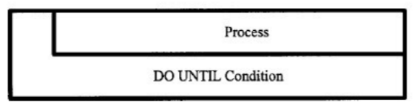
Repetition

Slide 7
Example 1
  A program is required to read three numbers, add them together and print their total.

Slide 8
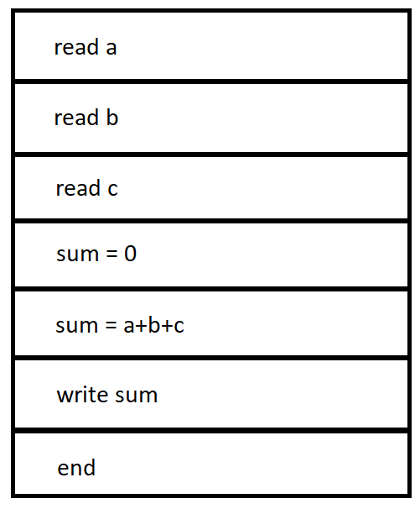
SEQUENCE

Slide 9
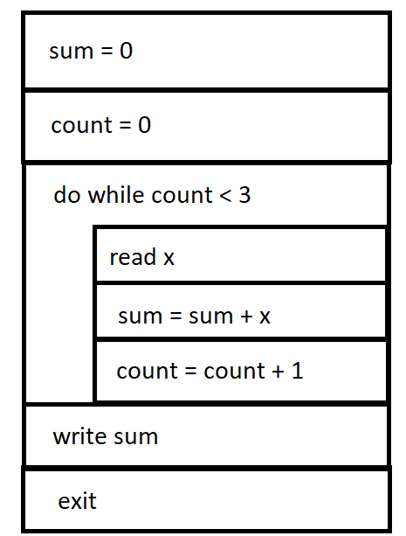
REPETITION

Slide 10
N-S Diagram and the selection control structure

Slide 11
Simple IF Statement
IF account_balance < $ 300
Yes
No
Service_charge = $ 5
Service_charge = $ 2

Slide 12
Null ELSE Statement
IF student_attendance = part_time
Yes
No
Add 1 to part_time_count

Slide 13
Combined IF Statement
IF student_attendance = part_time
AND
Student_gender = female
Yes
No
Add 1 to female_part_time_count

Slide 14
NESTED IF STATEMENT

Slide 15
A. Linear nested IF statement
IF record_code = ´A´
Yes
No
IF record_code = ´B´
Yes
No
Increment
counter_A
IF record_code = ´C´
Yes
No
Increment
counter_B
Increment
counter_C
Increment
error_counter

Slide 16
B. Non-linear nested IF statement
IF student_attendance = part_time
Yes
No
IF Student_gender = female
Yes
No
Add 1 to
full_time_students
IF student_age > 21
Yes
No
Add 1 to
male_
pt_students
Add 1 to
mature_female_
pt_students
Add 1 to
young_female_
pt_students

Slide 17
N-S Diagram and Case Structure
CASE OF single variable
Value 1
Value 2
Value 3
Value 4
Statement
block_1
Statement
block_2
Statement
block_n
Statement
block_other

Slide 18
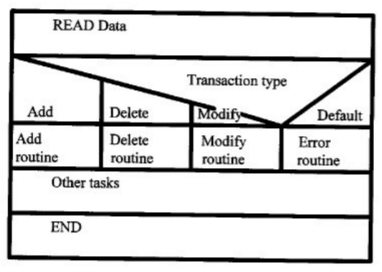
A data maintenance routine

Slide 19
N-S Diagram and the repetition control structure
DOWHILE condition p is true
 | Statement block

Slide 20
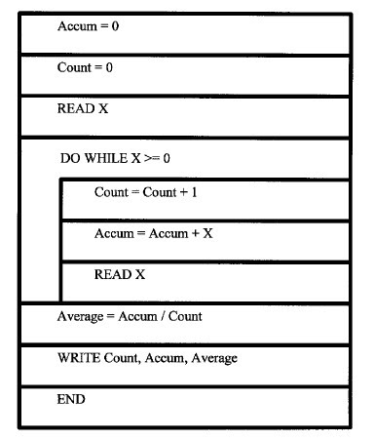
Figure 56.6 A Nassi-Shneiderman chart for computing an arithmetic average.
A Nassi-Shneiderman chart for computing an arithmetic average.

Slide 21
Assignment1. Print Examination Scores
A program is required to read and print a series of names and exam scores for students enrolled in a mathematic course. The class average is to be computed and printed at the end of the report. Scores can range from 0 to 100. The last record contains a blank name and a score of 999 and is not to be included in the calculations.

Slide 22
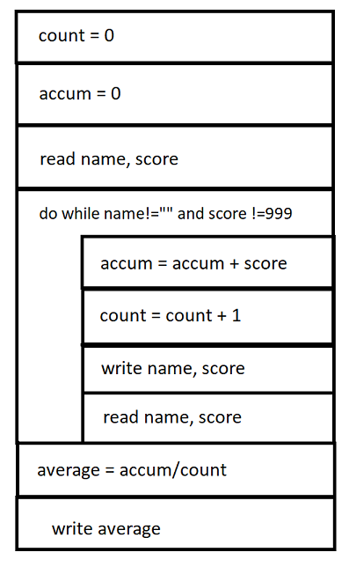

Slide 23
Assignment2. Process Inventory Items
A program is required to read a series of inventory records that contain item number, item description and stock figure. The last record in the file has an item number of zero. The program is to produce a low stock item report, by printing only those records that have a stock figure of less than 20 items. A heading is to be printed at the top of the report and a total low stock item count be printed at the end.

Slide 24
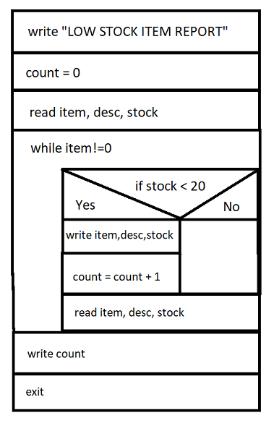

Slide 25


Slide 26
PURPOSE:
Nassi-Shneiderman charts were developed by Nassi and Shneiderman as an alternative to traditional logic flowcharts that provides a structured, hierarchical, graphical view of the flow of logic through a program, a routine, a module, or a process.
Used for documentation, planning and to design detailed programming logic.
DISADVANTAGES:
Nassi-Shneiderman charts should be in a single page with no more than 20 subdivisions.
Branch instructions to a different part of a code are not permitted. Only sequential execution is possible.

